Slide 1



Capgemini
CONS U LT I NG. TECHNOLOGY. 0 UT SOU RC I NG
People matter� results
count.
Fresher Learning Program
Teradata Training – Multi Load
Location, Date, Author

Slide 2

Module Object
▪
Introduction about Teradata Utility
▪
About Multi load
▪
Supporting Environment
▪
Multi Load Tasks
▪
Multi Load Tasks-IMPORT
▪
Phases of Import Task
▪
Example of Import Task
▪
Multi Load Tasks-Delete
▪
Example of Delete Task
▪
DELETE Task Differences from IMPORT Task
▪
Restarting Multiload
▪
MultiLoad Commands
Presentation Title | Date
Copyright © Capgemini 2015. All Rights Reserved 2

Slide 3
Introduction about Teradata Utility
What is the need of Teradata utilities in Data ware house
Quick access to data for more timely decision making.
•Solutions for the entire spectrum of load requirements from batch to near real
time.
•Unmatched scalability for large volume loads.
•Fail-proof loads with checkpoint restart capabilities.
•Proven technology from the data warehouse technology leader.
•Integration with industry-leading ETL and ELT tools.
Teradata Utilities
BTEQ: Help for Report formatting, Ad hoc query tool, Database administration, Best for small data
volumes
Multi Load :High-performance data unload in client format. Fast Load: High-performance initial table load.
Multi Load: High-performance maintenance operations applies updates to multiple tables in single pass.
Apart from these teradata having other utilities like Teradata Parallel Transporter, Tpump e.t.c.
Presentation Title | Date
Copyright © Capgemini 2015. All Rights Reserved 3

Slide 4
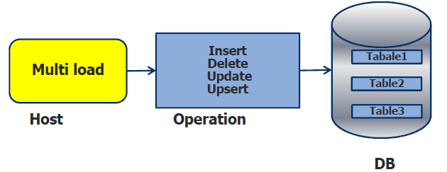
About Multi load
Multi load is a command driven parallel load utilities , used to load high volume of data to populated or empty
teradata tables and views. Teradata MultiLoad executes a series of MultiLoad commands and Teradata SQL statements written in a batch mode job script or interactively entered. The MultiLoad commands provide the session control and data handling specifications for the data transfer operations.
Features:--
Batch mode utility that runs on a server or host system. Supports up to five populated or empty tables.
Supports INSERTs, UPDATEs, DELETEs and UPSERTs; typically with batch inputs from a host file. Allows Duplicate rows.
Host and LAN support. Full Restart capability.
Error reporting via error tables.
Support for INMODs MULTILOAD HOST Teradata.
Presentation Title | Date
Copyright © Capgemini 2015. All Rights Reserved 4

Slide 5
About Multi
load
▪Advantages:--
•
Minimizes the use of the PEs.
•
Gets input data to the AMPs as quickly as possible.
•
Uses multiple-AMP sessions.
•
Uses the parallelism of the AMPs to apply changes.
•
Keeps BYNET activity low with AMP-local processing.
•
Avoids Transient Journaling overhead.
•
Allows Checkpoint/Restartability even with down AMPs.
•
Prevents lengthy rollbacks of aborted jobs.
•
Allows for maximum access to table during processing.
•
Posts errors to special error tables.
•
Provides extensive processing statistics
Presentation Title | Date
Copyright © Capgemini 2015. All Rights Reserved 5

Slide 6
Supporting Environment
The Multi Load utility is supported either on either the mainframe or on network attached system(LAN).
The LAN environment supports the following Operating Systems:
•UNIX MP-RAS
•Windows 2000
•Windows 95
•Windows NT
•UNIX HP-UX
•AIX
•Solaris SPARC
•Solaris Intel
The Mainframe (Channel Attached) environment supports the following Operating Systems:
•MVS
•VM
CAUTION: The Teradata RDBMS will only support a maximum of 15 simultaneous FastLoad, MultiLoad, or
FastExport utility job
Presentation Title | Date
Copyright © Capgemini 2015. All Rights Reserved 6

Slide 7

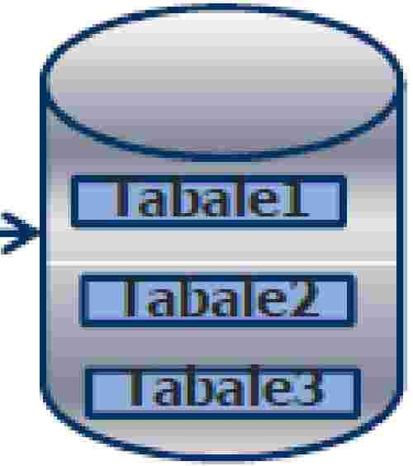







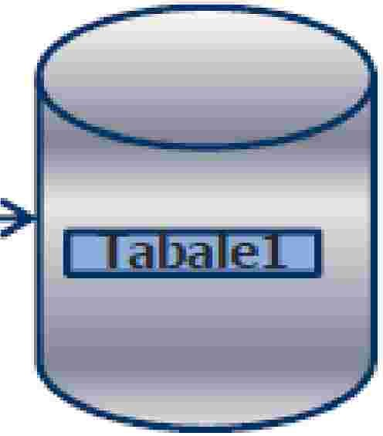
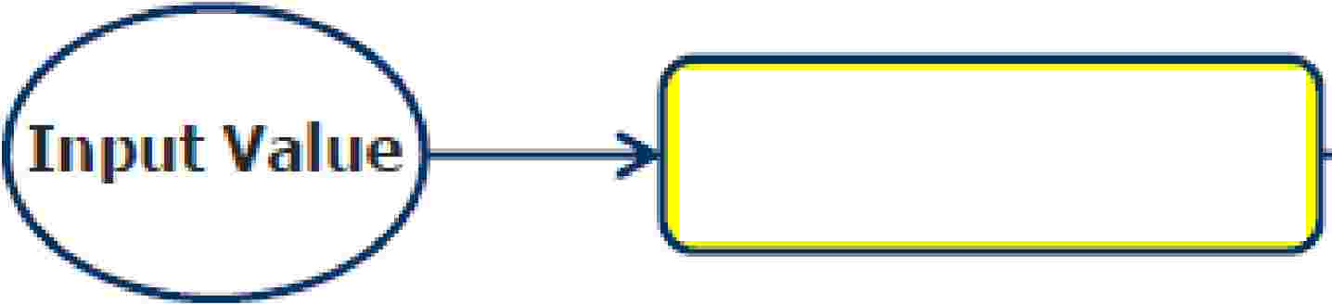




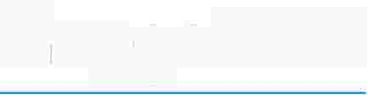
Multi Load Tasks
Basically Multiload use the source data and do the operation like Insert,Update,Delete and Upsert and
keep in Teradata table.
There are two types of tasks that Multiload can perform.
1:J
mport Taslk
Insert
Update
Input
Multi
load
Delete
u
Multi
loa�
Delete
Capgemmi
CON 5 ULT I NG. TECH NOL O G Y. 0 UT 5 0 UR CI NG
Presentation Title | Date
Copyright © Capgemini 2015. All Rights Reserved 7

Slide 8
Multi Load Tasks-IMPORT
▪
▪
▪
INSERTs, DELETEs, UPDATEs and UPSERTs are allowed.
Up to a maximum of five tables:–Empty or populated.–NUSIs permitted.
MultiLoad Import task operations are always primary index operations -however, you are not allowed
to change the value of a table’s primary index.
Change the value of a column based on its current value.
Permits non-exclusive access to target tables from other users except during Application Phase.
Input error limits may be specified as a number or percentage.
Allows restart and checkpoint during each operating phase.
IMPORT tasks cannot be done on tables with USI’s, Referential Integrity, Join Indexes, Hash
Indexes, or Triggers.–IMPORT tasks can be done on tables defined with “Soft Referential Integrity”.
▪
▪
▪
▪
▪
Presentation Title | Date
Copyright © Capgemini 2015. All Rights Reserved 8

Slide 9
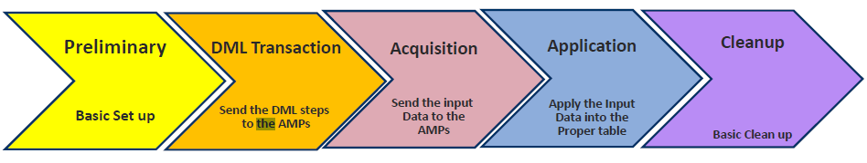
Phases
of
Import
Task
Presentation Title | Date
Copyright © Capgemini 2015. All Rights Reserved 9

Slide 10
Multiload: Preliminary
Phase
▪
•
Preliminary Phase:-
Validate the Multi load and SQL statements.
The first task is to be sure that the SQL syntax and MultiLoad commands are valid. MultiLoad
ensures that it is much better to identify any syntax errors, right up front. All the preliminary steps are automated, so no user intervention is required in this phase.
Establish all Sessions.
▪
Second, all MultiLoad sessions with Teradata need to be established. The default is the number of
available AMPs.
Presentation Title | Date
Copyright © Capgemini 2015. All Rights Reserved 10

Slide 11
Multiload: Preliminary Phase
▪ Preliminary Phase:-
•
Create Work Table Multiload create a work table for its support work. Work Table hold two things: the DML tasks
requested and the input data that is ready to APPLY to the AMPs. Default is in user’s default database and the
work table is named WT_TableName
Alternative may be specified as DataBaseName.WorkTableName
Example:
BEGIN [IMPORT] MLOAD
TABLES
WORKTABLES
Employee, Paycheck
util_db.WT_Emp ,
util_db.WT_Pay
…
•
Create Error Table MultiLoad requires two error tables per target table. The first error table
contains constraint violations, while the second error table stores Unique Primary Index violations.
Presentation Title | Date
Copyright © Capgemini 2015. All Rights Reserved 11

Slide 12
Multiload: Preliminary Phase
▪
Preliminary Phase:-
•Error table 1 (ET)
-Default is the user’s database and the table is named ET_Tablename.
-Contains any errors that occur in the Acquisition Phase.
-Contains primary index overflow errors that occur in the Application phase
•Error table 2 (UV)
-Default is the user’s database and the table is named UV_Tablename.
-Contains Application Phase errors.
-Uniqueness violations
-Constraint errors
-Overflow errors on columns other than primary index
Presentation Title | Date
Copyright © Capgemini 2015. All Rights Reserved 12

Slide 13
Multiload:
Preliminary
Phase
▪ Preliminary Phase:-
Example
BEGIN [IMPORT] MLOAD
TABLES Employee, PayCheck
WORKTABLES util_db.WT_Emp, util_db.WT_Pay
ERRORTABLES util_db.ET_Emp util_db.UV_Emp,
util_db.ET_Pay util_db.UV_Pay
. . . ;
▪Apply locks to target tables:
The final task of the Preliminary Phase is to apply utility locks to the target tables. Initially, access locks are placed on all target tables, allowing other users to read or write to the table for the time being. However, this lock does prevent the opportunity for a user to request an exclusive lock. Although, these locks will still allow the MultiLoad user to drop the table, no one else may DROP or ALTER a target table while it is locked for loading. This leads us to Phase 2.
Presentation Title | Date
Copyright © Capgemini 2015. All Rights Reserved 13

Slide 14
Multiload: DML Transaction
Phase
▪
DML Transaction phase:-
•All of the SQL Data Manipulation Language (DML)
statements are sent ahead to Teradata.
•Teradata's Parsing Engine (PE) parses the DML and generates a step-by-step plan to
•Execute the request. This execution plan is then communicated to each AMP and stored in the appropriate worktable for each target table.
•Add a USING modifier to
the request
and
host
data
to
be filled
in
from input
file.
Presentation Title | Date
Copyright © Capgemini 2015. All Rights Reserved 14

Slide 15
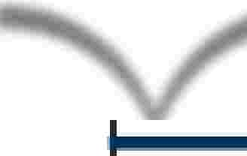


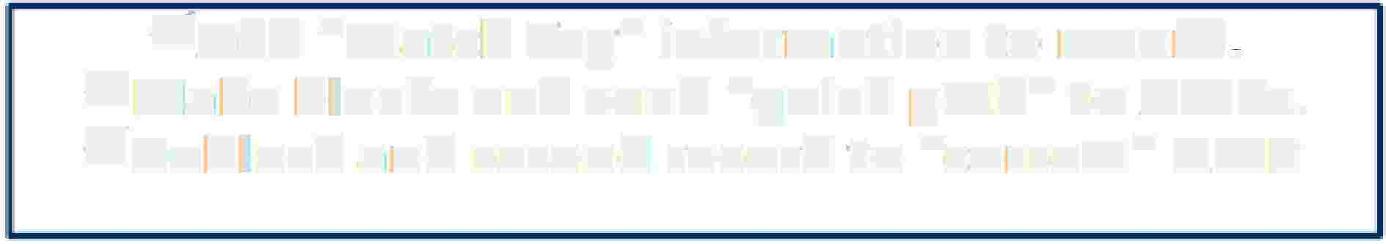



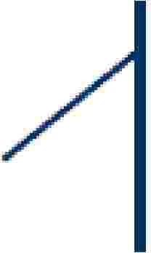



Multiload:
Acquisition Phase
Acguisit'"on Phase:-
,/Add e.. Match T.ag" information to record, v"'Ma�e blocks and send "qulck path" to AMPs. v"Deblock and resend record to "correct" A.MP
¹G1et the data from host and apply it to approprlate AMP worktables ...
v'Sort 1:lhe rebl ocik,edl records in1 the, w,ork. ta biles. v'Sort by [hash valu:e and sequence to be· applied
Re block and store in worktable off target table
v'Upg1radle locks on targ:et tables to W1rite.
v'Se,i-table headers for AiPiPI i¹catio1n phase.
Set up transition to the Application phase
• The lllock applied during this phase is:
O
v"
,/
A.1cquisit:ion ock
DML. -allows all
DDL -allows DROP only
Note::
A. Errors that occur in this phase go into the Acquisition Error Table
B,,. There is no acquisition phase activity for a DELETE Task
(default name is ET_ta lename).
Capgemmi
CON 5 ULT I NG. TECH NOL O G Y. 0 UT 5 0 UR CI NG
Presentation Title | Date
Copyright © Capgemini 2015. All Rights Reserved 15

Slide 16
Multiload: Application Phase
Application Phase:-
The purpose of this phase is to write, or APPLY, the specified changes to both the target tables and NUSI sub tables. To accomplish the substitution of data into SQL, when sending the data, the host has already attached some sequence information and five (5) match tags (describe in the next slide) to each data row. Those match tags are used to join the data with the proper SQL statement based on the SQL statement. In addition to associating each row with the correct DML statement, match tags also guarantee that no row will be updated more than once, even when a RESTART occurs.
▪
▪
Execute MLOAD for each target table as a single multi-statement request.
▪
End of host interaction until end of phase.
▪
AMPs independently apply changes to target tables.
▪
Executed as a single transaction without rollback.
▪
Restartable based on last checkpoint.
▪
No transient journal needed.
▪
The lock applied during this phase is:
•Application lock
•DML —allows SELECT with ACCESS only
•DDL —allows DROP only
Note: Errors that occur in this phase go into the Application Error Table
(default name is UV_tablename).
Presentation Title | Date
Copyright © Capgemini 2015. All Rights Reserved 16

Slide 17
Multiload: Cleanup Phase
▪
Cleanup Phase:-
If the last error code is zero (0), all of the job steps have ended successfully. If this being the case,all error tables made emptied, worktables and the log table are dropped. All locks, both Teradata and MultiLoad, are released. The statistics for the job are generated for output (SYSPRINT) and the system count variables are set. After this, each MultiLoad session is logged off. Below are the summary of the activities:
All
locks are released.
•Table headers are restored across all AMPs.
•Dictionary cache of Target Tables is spoiled.
•Statistics are reported.
•Final Error Code is reported.
•Target tables are made available to other users.
•Work Tables are dropped.
•Empty Error Tables are dropped.
•Log Table is dropped (if Error Code = 0).
Presentation Title | Date
Copyright © Capgemini 2015. All Rights Reserved 17

Slide 18

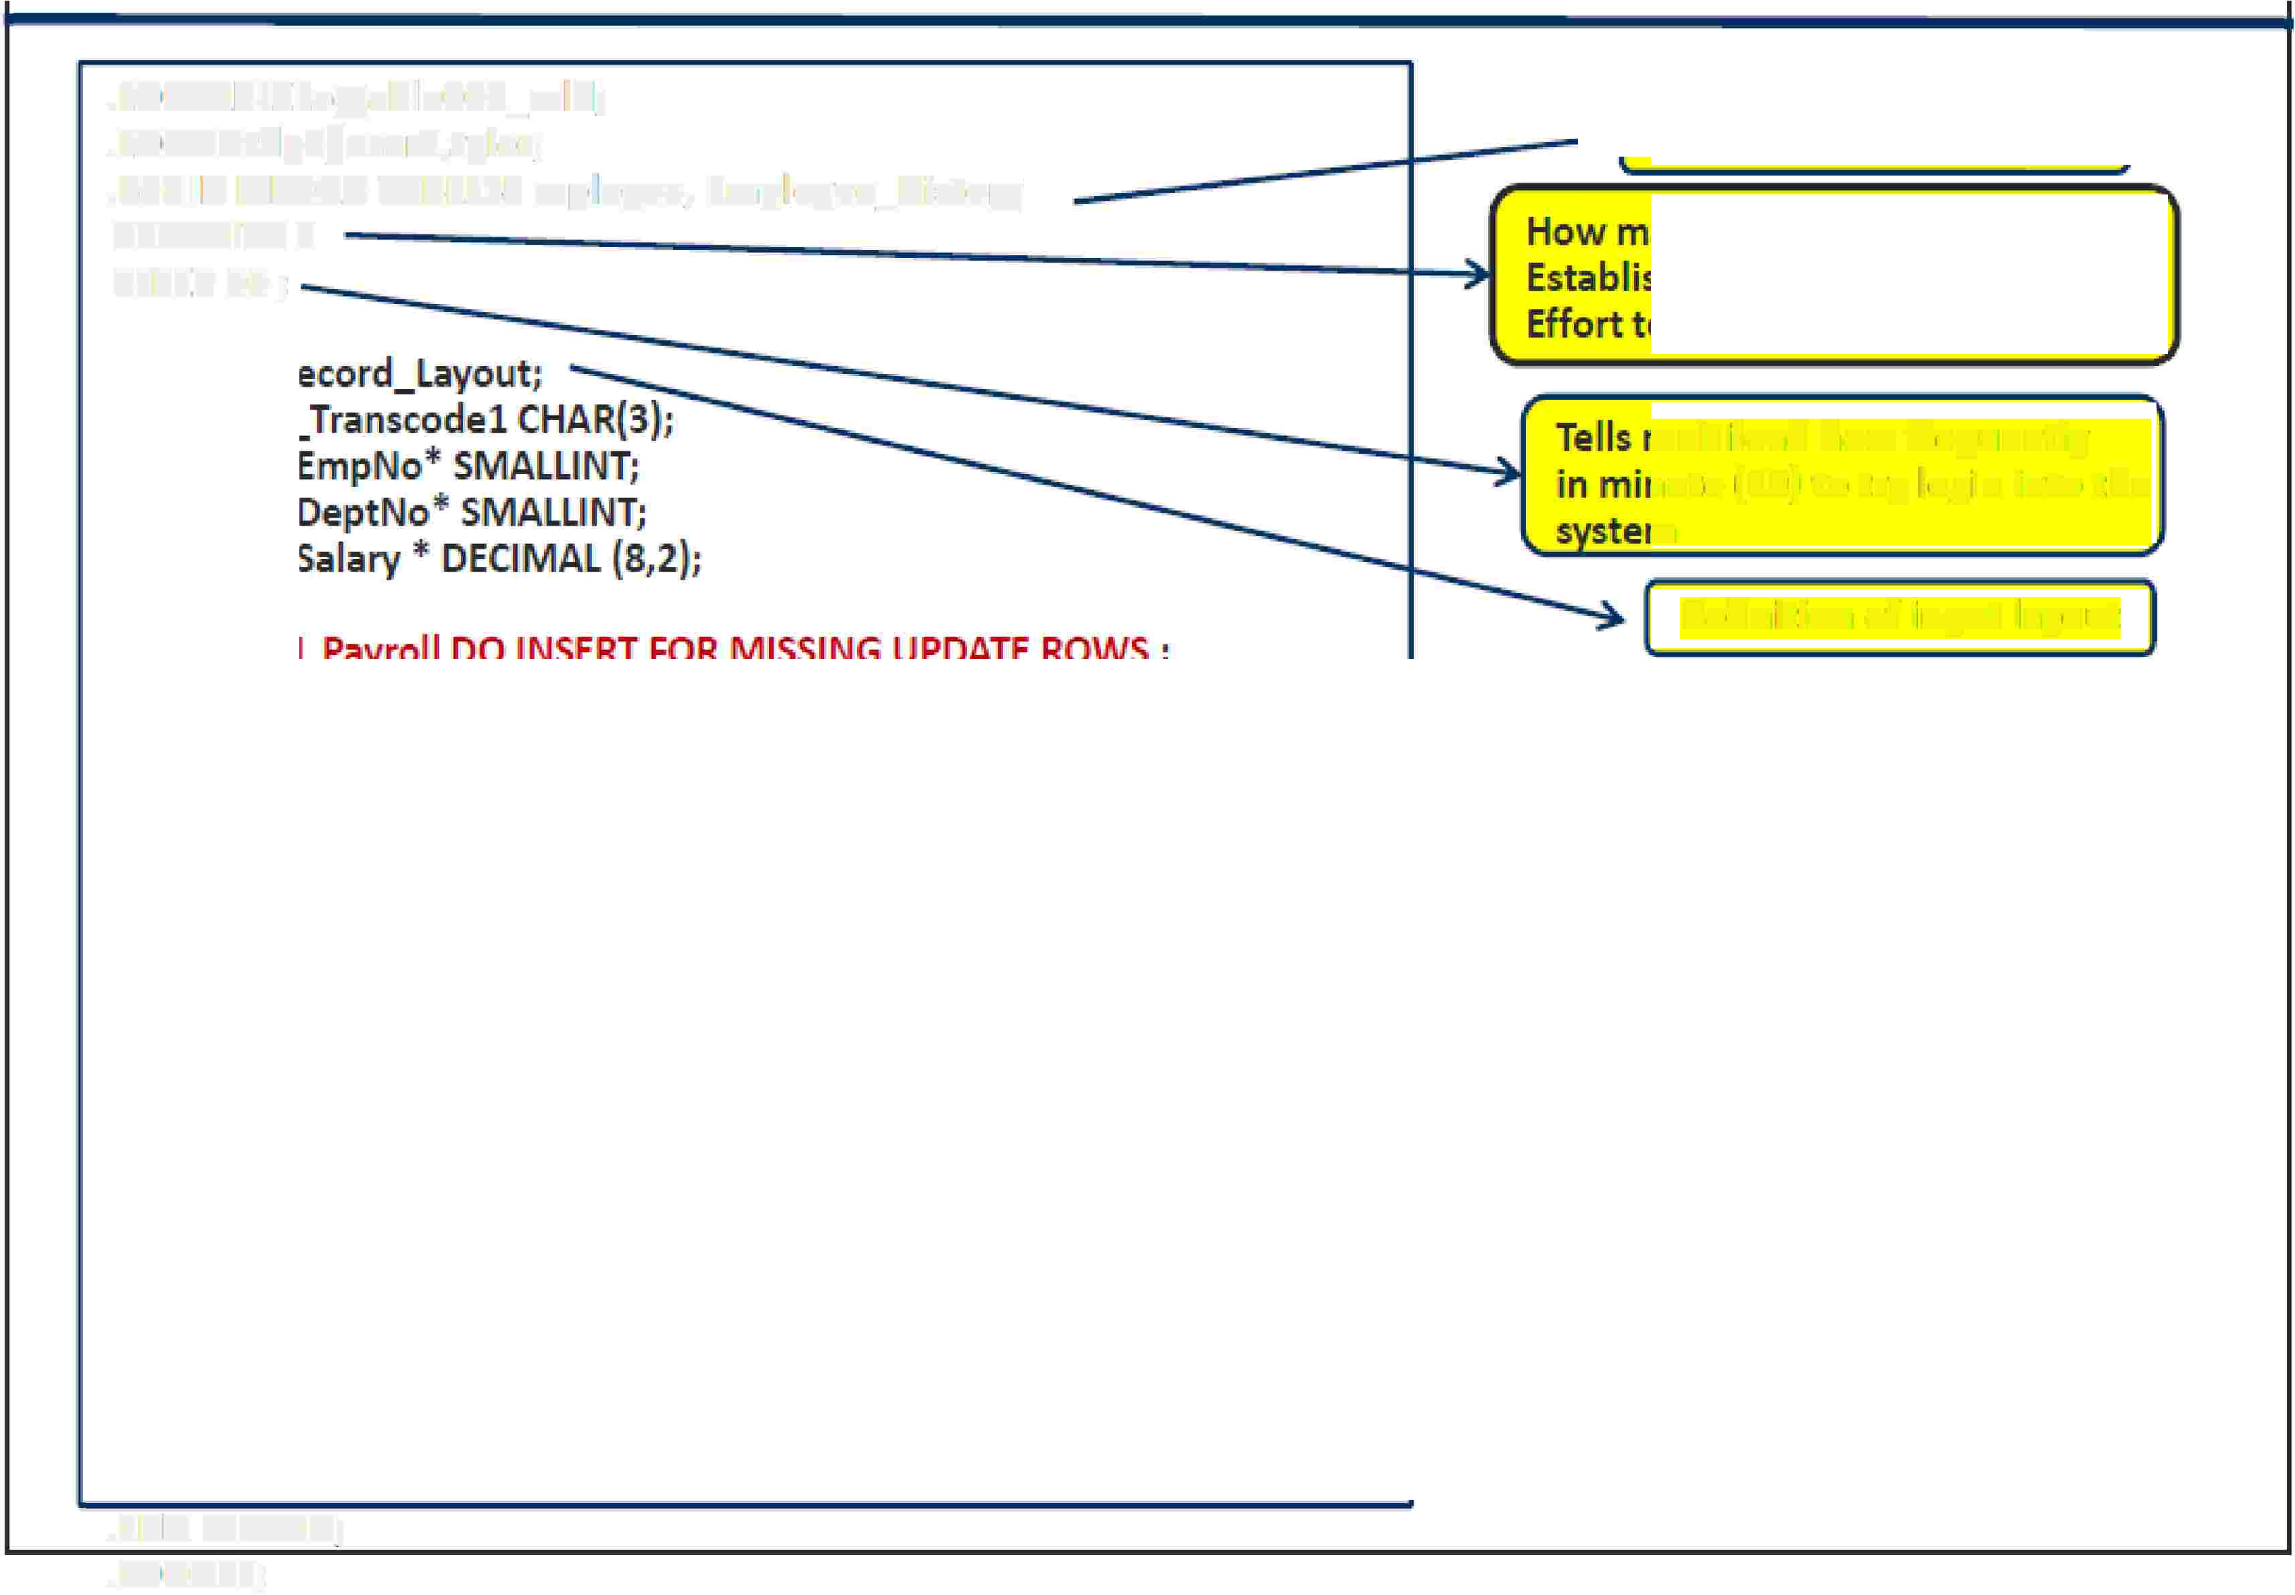










Example
of
Import
Task
.LOGTAIBlElogtablleOO'l_,mlld;
• LOGrONtd p3/ useir:2,,tyl er;
.BEGIIN MLOAD lABLESE m1plo,yee, Emplloyee_Histo1ry
TEINACITY2
SLEEP 10;
Begin Loading
How many hours ( 2 ) to try
Establishing session when initial
Effort to do so is rebuffed
.lAYOUTRe1co1rd_lay1out:; ,
.FILLIER i'n_lransoodel CHAR(3.);
.FIELD, iin_Eim1P,INl10* SMALLINT;
.FIELD in_DeptNo* SMALLINIT;
.FIELD in_Salary * DECIMAL {8�2,);
Tells multi load how frequently
in minute (10) to try login into the stem
.DMIL lABEL Payr,oll DO IINSERT FOR IMISSIING UPDATE ROWS;
Definition of input layout
UPDATE Employee SET Salary·= :iin_Sala1ry
WHIERE Em1pNo= ::inJEm1pNo;
Definition of an UPSERT.
INSEIRTIN1TOEm1ployee (IEm1pNo, S,al,a1ry)
VALUES(::iin_Em1PH0, :in....:,Sallary);
.DMIL lABEL Terminate j:
DElETEFIROM !Employee WHERE IEmpNlo= ::in_,EmpN¹o;: INSERT INTO Emplloyee_Histo1ry (IEm1pNlo,. De1n,,';lll!A...--�
VAlJU ES. {:: in_Eim1p,No, : il!Jm1-.lJalptf;�-
lfi le name to ·mport from
.IMPOIRT IINFlllE iirnfiilel
End
loading.
LAYOUlRecord�_;L;y;o�u;t!,.l[il.ll1SJ:o1Mle'9:!'tl'!:-::::�------------------�--------71
APP LY Payro II �HIE RE in I
APPLY Termin e : ERIE in_Tra1nscode= ¹DEL¹
;
.ENID MLOAD;
.LO GOFF;
Capgemmi
CON 5 ULT I NG. TECH NOL O G Y. 0 UT 5 0 UR CI NG
Presentation Title | Date
Copyright © Capgemini 2015. All Rights Reserved 18

Slide 19
Multi Load Delete Task
▪
Not part of Multiload Import, which consider the
statement.
sql “Delete”
▪
▪
▪
▪
Not follow the Transient Journal like Import
No Rollback applies, when job failed.
Delete
.
Follow the Restartibilty and check
points.
Not
consider
the
Primary
Index.
Presentation Title | Date
Copyright © Capgemini 2015. All Rights Reserved 19

Slide 20
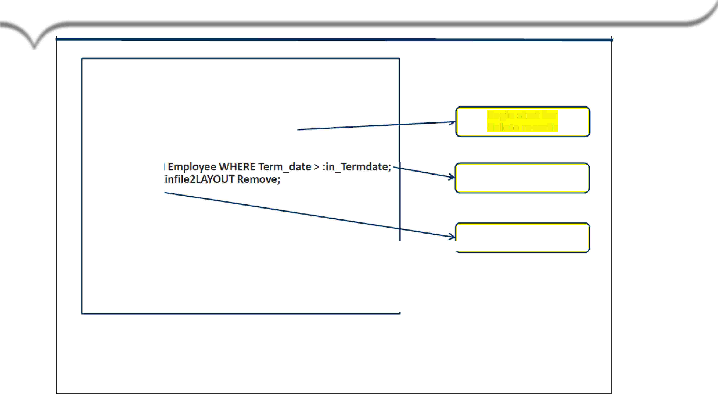



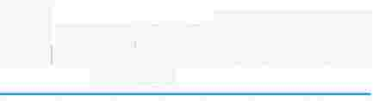
Example
of
Delete
Task
..LOGTABLE ILogta bl1e003_mid
.. LOGON tdlp3/user2.,tyler
,. B,EGI N DELETE MLOAD TA.BLES Employiee
.. LA.VOUT R1emove;
.FIELD inTermdlate* INITEGER;
DELETE FROM Employ·e¹e WHERE le·rm_date > :in_J�ermdate;
. IMPORT INIFII LEinfUe2LAYOUT Remov·e;
.. END MI.JOA.D;
.LOGOFIF;
Begin stmt for
delete records
Delete stmt
End Mload
Capgemmi
CON 5 ULT I NG. TECH NOL O G Y. 0 UT 5 0 UR CI NG
Presentation Title | Date
Copyright © Capgemini 2015. All Rights Reserved 20

Slide 21


www.capgemini.com
DELETE Task Differences from IMPORT Task
•
DELETE tasks operate very similarly to IMPORT tasks
with some differences:
•
•
•
•
Deleting based on a equality UPI Value is not permitted.
A DML DELETE statement is send to each AMP with match tag parcel.
No Acquisition phase.
Application Phase reads all target blocks and deletes qualifying rows.
•
Multiload Delete vs SQL Delete.
• Multi load Delete is Faster as compared to SQL Delete.
• Multi load Delete is restartable.
The information contained in this presentation is proprietary.
Copyright © 2015 Capgemini. All rights reserved. Rightshore® is a trademark belonging to Capgemini.

Slide 22
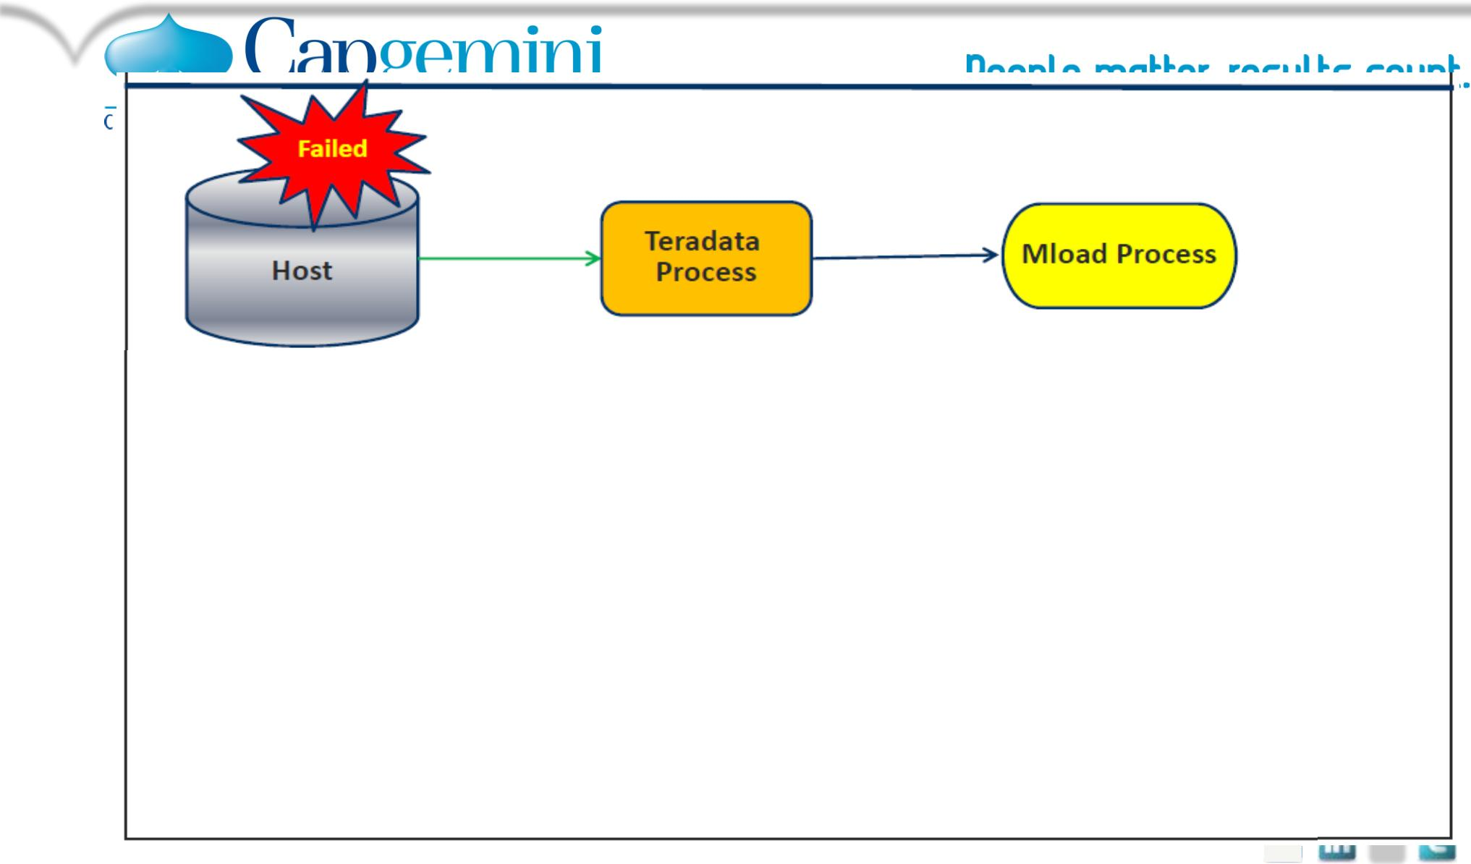





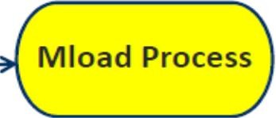


www.capgemini.com
Restarting
Multiload
Teradata
Process
Resubmit the original script.
MLOAD determines its stopping point and restarts.
Teradata
Process
Host
MLOAD reinitiated automatically after Teradata recovery.
Continue from checkpoint without user interaction.
..
The information contained in this presentation is proprietary.
Copyright © 2015 Capgemini. All rights reserved. Rightshore® is a trademark belonging to Capgemini.

Slide 23
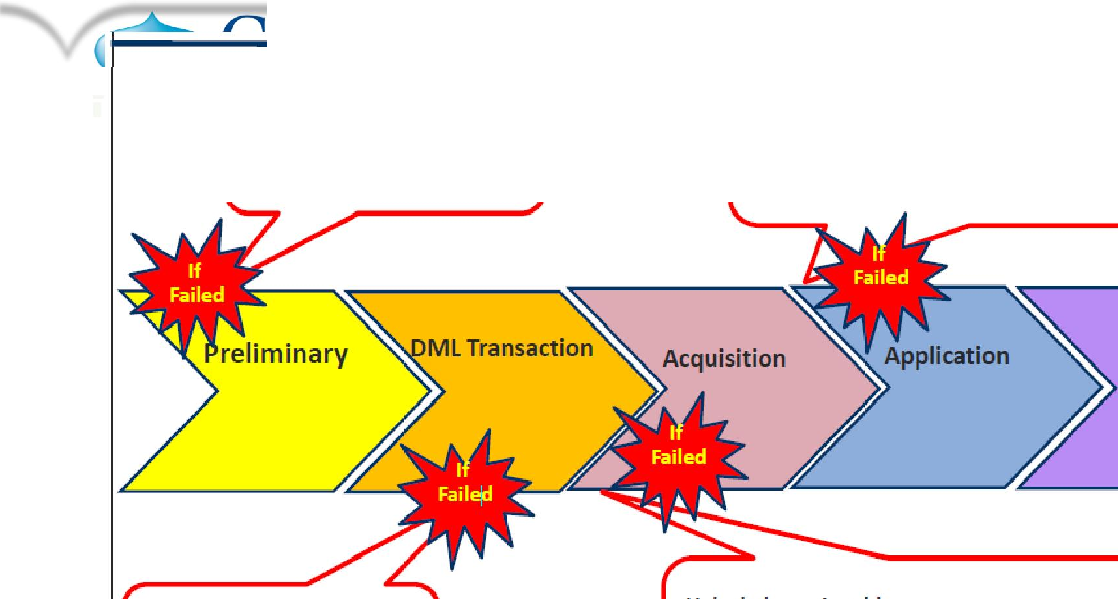
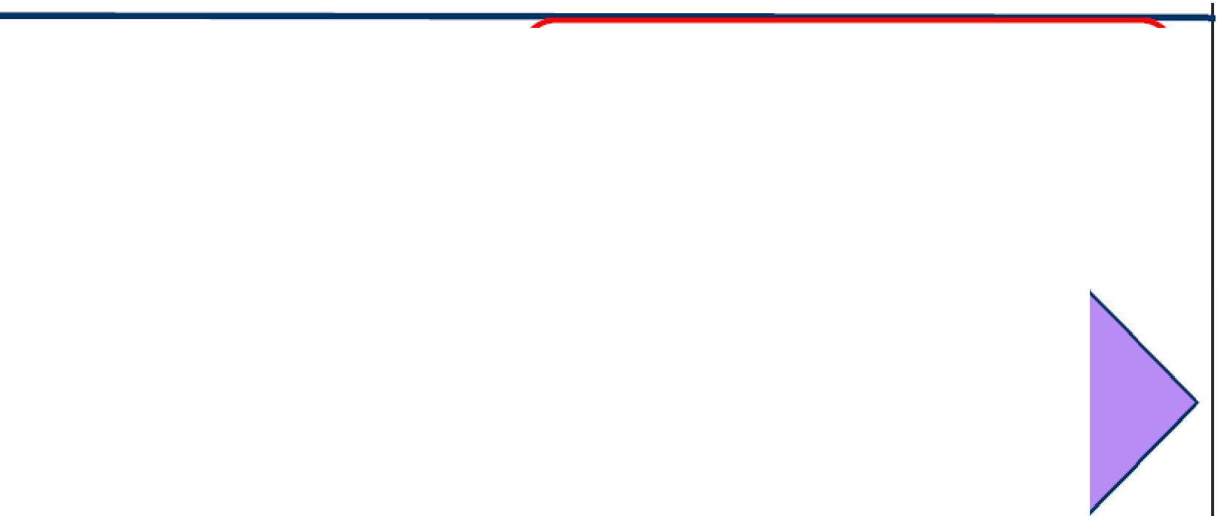






www.capgemini.com
Restarting Multiload
•
•
⁻c simply resubmitting the job again and
Correct the script and
Rerun again.
it will be fine and start from the checkpoint.
OR
drop the two error ta,bles one work table one log table and release mload from the target table.
Cleanup
Correct the script and
Rerun again.
Unlock the main table,
by using the command.
RELEASE MLOAD <DATABASENAME.TABLE NAME>;
The information contained in this presentation is proprietary.
Copyright © 2015 Capgemini. All rights reserved. Rightshore® is a trademark belonging to Capgemini.

Slide 24

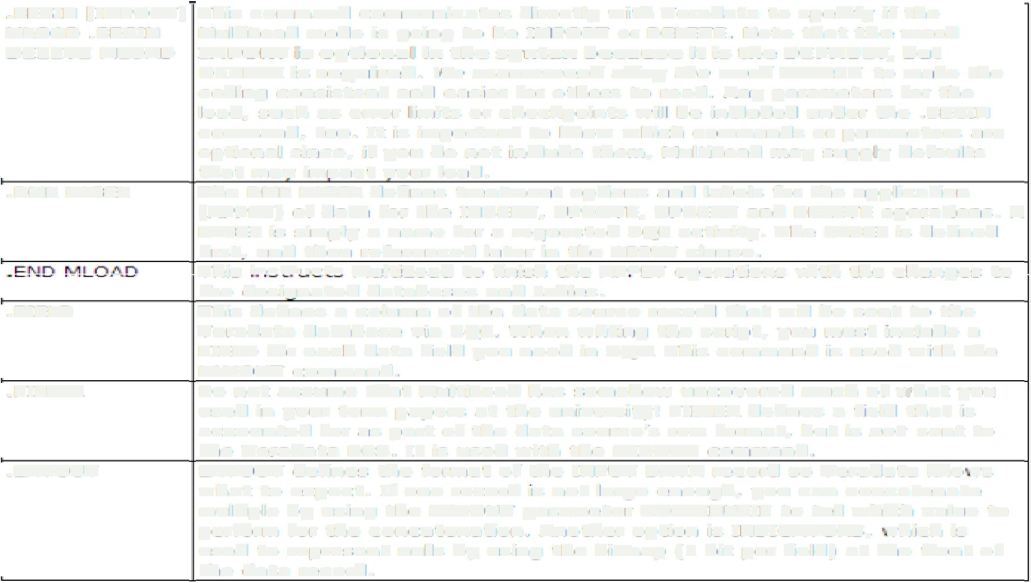
www.capgemini.com
MULTILOAD COMMAND
.BEGIN
MLOAD
=IMPORT]
.BEGIN
This command communicates directmy with Te!J"'adata to specify if the
MulbiLo.ad mode is going to be IMPORT or DELETE. Note that the W'ord
DE1LETE MLOAD
£MPORT is. opt:ional iin ilthe synl:ax because it. iis. ·the DIE FAULT"
DELETE is required. !Ve recomrnend usin9 Ehe. word IMPORT to
coding consistent and easier for others t:o read. Any parameters
but
make tine
for the
load, such as error limits or checkpoints will be included under the . BEGIN
c crnrnerrd, too. It is importa111t ro know which commands or parameters are
optional since, if you do not include them, Mult1iLoad may supply defaults
that may impact your load.
The DML IL.ABEL defines treatment options and labels for the application
{APPLY) of data for tihe INSERT, UPDATE, UPSERT and DELETE op ere tioris ..A LABEIL is simply a name for a requested SQL activity. The LABEL is defined first, and th12n referencsd later �n the APPLY clause.
This •..-..et...-, • .-lt-'e Mu!!!:iLoad to f!:n!sh the l\PDLY cper-.a tiorrs ·�.dth the ch.ariges to
t1,1e desiqnated databases and tables.
This defines a column of the· data sourrce record that will be sent to the
Teradata database via SQL. \.i\llhen writing the script� yo._1 must rnciude a
FIELD for each data field you need in SQL. This c ornrriarrd is used with the
L...�,YOUT command.
Do not assume that MultrLoad ha1s somehow uncovered rrurcb of vfi·hat y,o._,
.DML LABEL
.FIELD
.FILLER
used in your terr1n papell"S at the university!
FILLER defines a field that is
row format,, but: is not: sent to
accounted for as part of the
data
with
source's
tlle
Teradata DBS. It is used
the LAYOUT comrnarid:
lNPUT DATA record so Teradata kno rr1s
.LAYOUT
LAYOUT defiines the format of the
what to expect. If one record 1s not: large enough,, you
can concat:,enate
multiple by using the LAYOUT parameter CONTINUEIF t:o tell which value to
perform for the conc.atenation. Another option is INDICATORS, ri1hich is
used to represent: nulls by using the bitn,ap ( 1 bit per field) at. the front of
tlle data record.
The information contained in this presentation is proprietary.
Copyright © 2015 Capgemini. All rights reserved. Rightshore® is a trademark belonging to Capgemini.

Slide 25


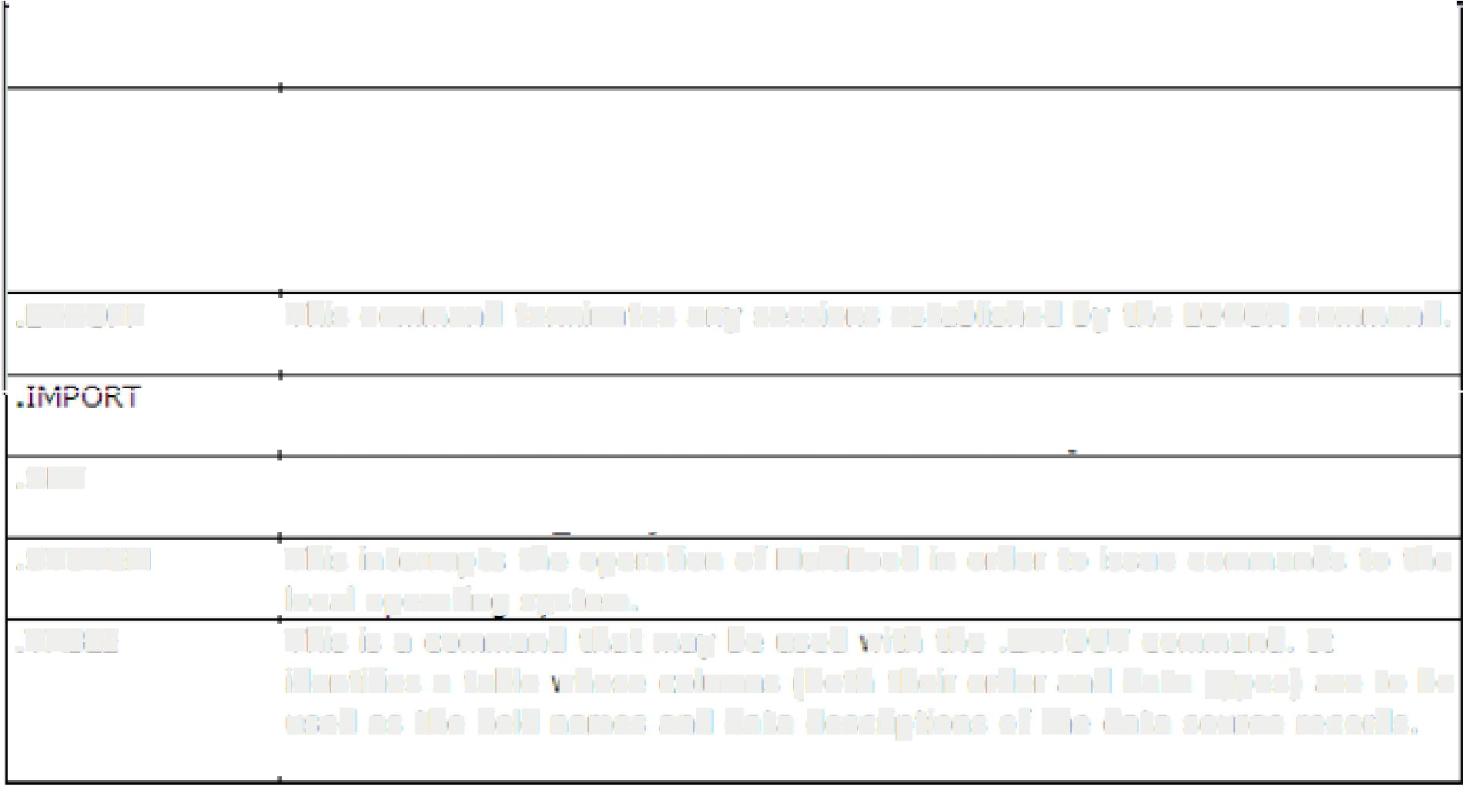



www.capgemini.com
r_{. aT""\CTOYYl} ..
MULTILOAD
COMMAND
-
lYll
• •
••
.LOG ON
This specifies the username
Multiload with Teradata.
or LOGON string that � ill establish sessions for
�LOGTABLE
This support command names the name of the Restart Log that will be used
for stoning CHECKPOINT data pertaining to a load. The LOGT BLE is then
used to tell Multiload ri.there to RESTART1 should that be necessary. n is
recommended that this command be placed betor«
the .LOGON commend.
• LOGO FF
This corumand
-·.
terminates any sesslons
es.ta,blished
by the
lOGON command .
I
I ,-
.-.
ueunes uie 11�1-'U I U,l!,lLi I A
i1L...t:, rue I.Yl,J!.':₁ 1111;'
IU;i';d�t:₁ uie
I rll;i, �UUll!ldllU
' I
LAYOUT to use and �11here to APPLY the data to SQL.
Optionally, you can SET utility variables. An example would be {.SET
DBName TO �CD.ILLTest�}.
This interrupts the operation of Multil.cad in order to issue commands to the
local operating system.
This is a command that may be used vith the .LAYOUT command. It
.. SET
.SYS,TEM
.TABLE
identifies a table vhese columns roott, their order and data
types) are to be
used as the field names and data descriptions of the data source records.
The information contained in this presentation is proprietary.
Copyright © 2015 Capgemini. All rights reserved. Rightshore® is a trademark belonging to Capgemini.

Slide 26






www.capgemini.com
MULTILOAD Parameters
Parameter
SESSIONS
Description
This refers to the number of SESSIONS that should be
established with Teradata. For Multiload, the optimal number
of sessions is the number of AMPs in the system, plus two more.
(One for Control functions arid other is for the backup purpose).
You can also use MAX or MIN, which automatically use the
maximum or minimum number of sessions to complete the job.
If you specify nothing, it will default to MAX.
SLEEP
Tells Multi Load how frequently, in minutes, to try logging on to
the system.
Tells Multi Load how many hours to try logging on when its initial
effort to do so is rebuffed.
TENACITY
The information contained in this presentation is proprietary.
Copyright © 2015 Capgemini. All rights reserved. Rightshore® is a trademark belonging to Capgemini.

Slide 27
www.capgemini.com
Limitation of MultiLoad
▪
Though MultiLoad is a very powerful utility; it has following limitations:
➢ 1. MultiLoad Utility doesn’t support SELECT statement.
➢ 2. Concatenation of multiple input data files is not allowed.
➢ 3. MultiLoad doesn’t support Arithmetic Functions i.e. ABS, LOG etc. in Mload Script.
➢ 4. MultiLoad doesn’t support Exponentiation and Aggregator Operators i.e. AVG, SUM
etc. in Mload Script.
➢ 5. MultiLoad doesn’t support USIs (Unique Secondary Indexes), Referential Integrity,
Join Indexes, Hash Indexes and Triggers.
➢ 6. Import task require use of PI (Primary Index).
The information contained in this presentation is proprietary.
Copyright © 2015 Capgemini. All rights reserved. Rightshore® is a trademark belonging to Capgemini.

Slide 28
www.capgemini.com
Q
&
A
The information contained in this presentation is proprietary.
Copyright © 2015 Capgemini. All rights reserved. Rightshore® is a trademark belonging to Capgemini.

Slide 29
www.capgemini.com
MultiLoad Review Questions
•
Answer True or False.
•
1. With MultiLoad, you can import data from the host into populated tables.
True or False.
•
2. MultiLoad cannot process tables with USIs or Referential Integrity defined.
True or False.
•
3. MultiLoad allows changes to the value of a table’s primary index.
True or False.
•
4. MultiLoad allows you to change the value of a column based on its current value.
True or False.
•
5. MultiLoad permits non-exclusive access to target tables from other users except during Application Phase. True or False.
Match the MultiLoad Phase in the first column to its corresponding task in the second column.
1. Preliminary
A. Acquires or creates Restart Log Table.
B. Locks are released.
C. Applies (loads) data to the work tables.
D. Execute mload for each target table as a single multi-statement
request.
E. Stores DML steps in work tables.
2. DML Transaction
3. Acquisition
4. Application
5. Cleanup
The information contained in this presentation is proprietary.
Copyright © 2015 Capgemini. All rights reserved. Rightshore® is a trademark belonging to Capgemini.

Slide 30
www.capgemini.com
Answers of MultiLoad Review Questions
Match the MultiLoad Phase in the first column to its corresponding task in the second column.
1.
2.
3.
4.
(A) Preliminary
(E) DML Transaction
(C) Acquisition
(D) Application
A. Acquires or creates Restart Log Table.
B. Locks are released.
C. Applies (loads) data to the work tables.
D. Execute mload for each target table as a single multi-statement
request
E. Stores DML steps in work tables
5.
(B) Cleanup
The information contained in this presentation is proprietary.
Copyright © 2015 Capgemini. All rights reserved. Rightshore® is a trademark belonging to Capgemini.

Slide 31
ANSWERS OF MULTILOAD REVIEW
QUESTIONS
•
With MultiLoad, you can import data from the host into populated
tables.
TRUE
▪
MultiLoad cannot process tables with USIs or Referential Integrity
defined.
TRUE
FALSE
▪
MultiLoad allows changes to the value of a table’s primary index.
▪
MultiLoad allows you to change the value of a column based on its current
value. .
TRUE
▪
MultiLoad permits non-exclusive access to target tables from other users
except during Application Phase.
TRUE
Presentation Title | Date
Copyright © Capgemini 2015. All Rights Reserved
31

Slide 32
www.capgemini.com
MultiLoad LAB Exercise
▪
Purpose:
– In this lab, you will use MultiLoad utility to insert the data rows in OLAP_EXAMPLE table. We
use the Linux/Unix environment to execute the script.
▪
What you need:
– The required table and data file.
▪
Tasks:
•
1.Prepare a MultiLoad script which inserts rows into the table using the redefinition feature of
MultiLoad.
Note: The Trans_Date is exported with an ANSI Date Format of 'YYYY-MM-DD' and a data type of
CHAR(10).
• 2. Ensure that the table has been created in the database properly.
• 3. Run the script.
The information contained in this presentation is proprietary.
Copyright © 2015 Capgemini. All rights reserved. Rightshore® is a trademark belonging to Capgemini.

Slide 33


About Capgemini
With almost 145,000 people in over 40 countries, Capgemini is one of the world's foremost providers of consulting, technology and outsourcing services. The Group reported 2014 global revenues of EUR 10.573 billion.
Together with its clients, Capgemini creates and delivers business and technology solutions that fit their needs and drive the results they want. A deeply multicultural organization, Capgemini has developed its own way of working, the Collaborative Business Ex perienc e™ , and draws on Rightshore®,
its worldwide delivery model.
Learn more about us at www.capgemini.com.
www.capgemini.com
The information contained in this presentation is proprietary.
Copyright © 2015 Capgemini. All rights reserved. Rightshore® is a trademark belonging to Capgemini.

